Slide 1
DOM
(Document Object Model)

Slide 2

Presented by---
Agnish Majumder
Anindya Sundar De
Gopal Basak
Rashbihari Halder

Slide 3

Contents
Introduction
Pre-knowledge
Definition
Types of DOM
DOM hierarchy
Tree structure
Advantages and Disadvantages
Conclusion

Slide 4

Introduction
The Document Object Model (DOM) is a programming API(Application Programming Interface) for HTML and XML documents.
DOM defines the logical structure of documents and the way a document is accessed and manipulated.

Slide 5
Pre-knowledge
Before going to DOM we have to know about -
HTML (Hyper Text Markup Language): How to Display the Data in the Webpage.
XML (Extensible Markup Language): How to Describe the Data .
DHTML (Dynamic HTML): How to Add Movement or Animation to an HTML Document.
JAVASCRIPT: How to make Web Content Dynamic.

Slide 6
Definition of DOM
The W3C Document Object Model (DOM) is a platform and language-neutral interface that allows programs and scripts to dynamically access and update the content, structure, and style of a document.
The DOM defines the objects and properties of all document elements and the methods (interface) to access them.
The DOM is a W3C (World Wide Web Consortium) standard.
The DOM defines the logical structure of objects and the way an object is accessed and manipulated.

Slide 7
Types of DOM
There are mainly 3 parts or levels of DOM---
Core DOM - standard model for any structured document
XML DOM - standard model for XML documents
HTML DOM - standard model for HTML documents

Slide 8
The DOM Programming Interface
In the DOM, all HTML elements are defined as objects.
The programming interface is the properties and methods of each object.
A property is a value that one can get or set (like changing the content of an HTML element).
A method is an action one can do (like adding or deleting an HTML element).

Slide 9
DOM Document
Method | Description
document.getElementById() | Returns the element that has the ID attribute with the specified value
document.getElementsByClassName() | Returns a Node List containing all elements with the specified class name
document.getElementsByTagName() | Returns a Node List containing all elements with the specified tag name
DOM Events
Event | Description
onclick | The event occurs when the user clicks on an element
onmouseover | The event occurs when the pointer is moved onto an element, or onto one of its children

Slide 10
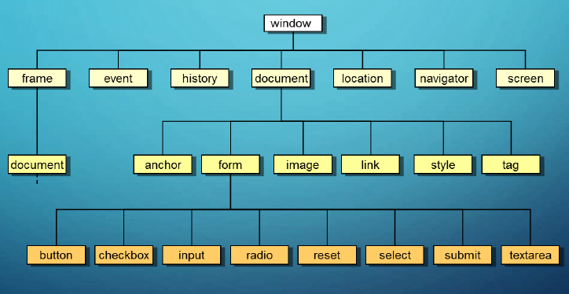
DOM hierarchy

Slide 11

Tree Structure
The tree structure of DOM is known as Node-tree
All the nodes in this tree have relationship with each other.

Slide 12
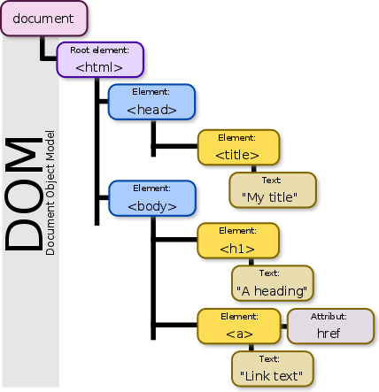
Nodes in tree
The DOM represents documents as a hierarchy of Node objects.
Element Node – contains an HTML tag
Text Node – contains text
Attribute node – Represents attribute of Element node
Text Nodes are contained within Element Nodes
Example : <body bgcolor=“blue”> JIS </body>
Here, <body> is element node, “bgcolor” is attribute node and “JIS” is text node

Slide 13
Relationship among Nodes
Every node has exactly one parent node (except root) and a parent node can have one or more than one child nodes.
Root node :- The topmost node of the tree is the root node. As it is topmost, so there is no parent of this root node.
Leaf :- The leaf nodes are the nodes which have no child node.
Siblings :- The nodes which have same parent are the siblings of each other.

Slide 14
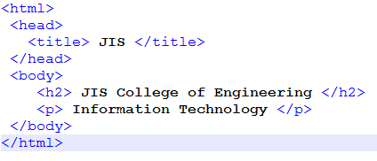
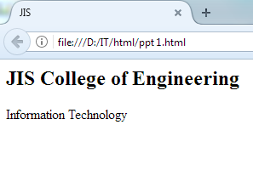
Example of parent-child relationship

Slide 15
Tree representation
<html>
Here <html> node is the root node as it has no parent.
<head> and <body> are two child nodes of <html>
<h2> & <p> are siblings .
JIS, JIS College of Engineering etc are the leaf nodes.
<head>
<body>
<title>
<h2>
<p>
JIS College of Engineering
Information Technology
JIS

Slide 16

HTML DOM-Access nodes
We can access a node in three ways:
1. By using the getElementById() method
2. By using the getElementsByTagName() method
3. By navigating the node tree( using the node relationships )

Slide 17
The getElementById() Method
This method returns the element with the specified ID
Syntax--
document.getElementById("ID");
The getElementsByTagName() Method
This method returns all elements with a specified tag name
Syntax--
document.getElementsByTagName("tagname");

Slide 18
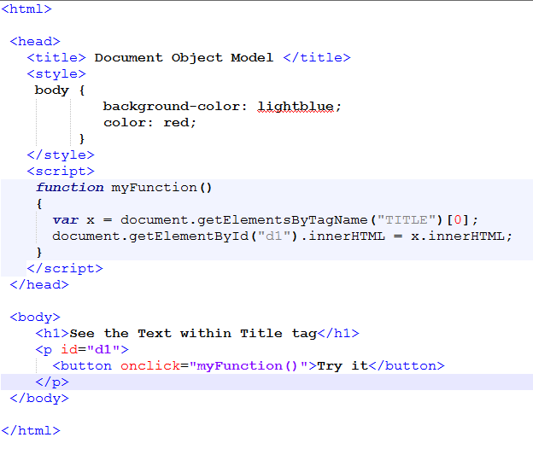
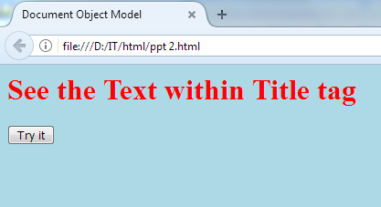
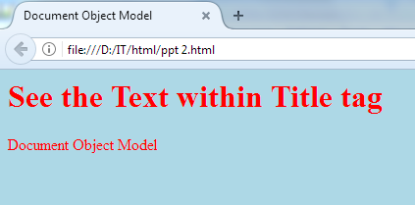
Example

Slide 19
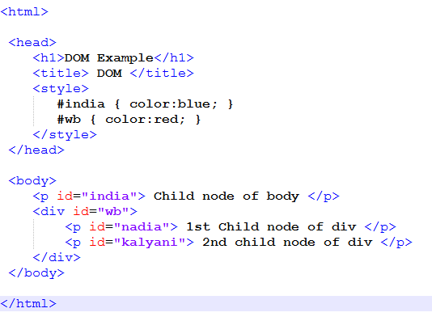
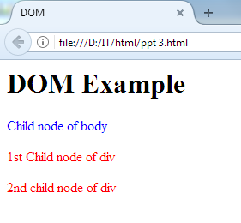
Navigating node-tree
The three properties parentNode, firstChild, and lastChild follow the document structure and allow short distance travel in the document.

Slide 20
DOM Advantages and disadvantages
Advantages
Robust API for the DOM tree
Relatively simple to modify the data structure and extract data
Disadvantages
Stores the entire document in memory
As Dom was written for any language, method naming conventions don’t follow standard java programming conventions

Slide 21
Conclusion
DOM is a tree representation of an XML document in memory.
With the help of DOM the tree structure of any HTML or XML code can be easily implemented.
DOM helps to make a proper sense about the parent and child nodes in a tree structure of a code.
The document object model can be thought of as a hierarchy moving from the most general object to the most specific.

Slide 22

For your patience

